Slide 1
Implementing RNN

Slide 2
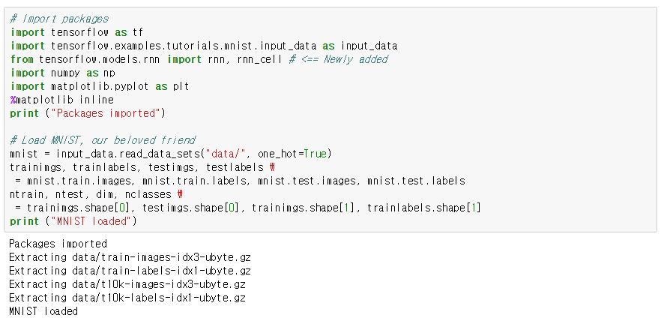
Load packages

Slide 3
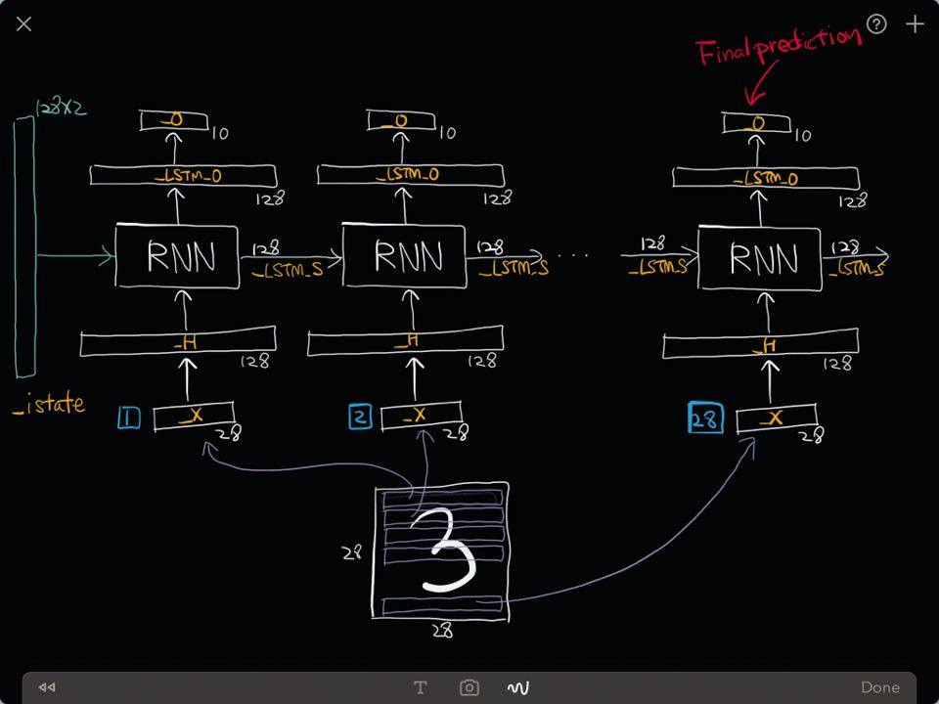
We will make following RNNs

Slide 4
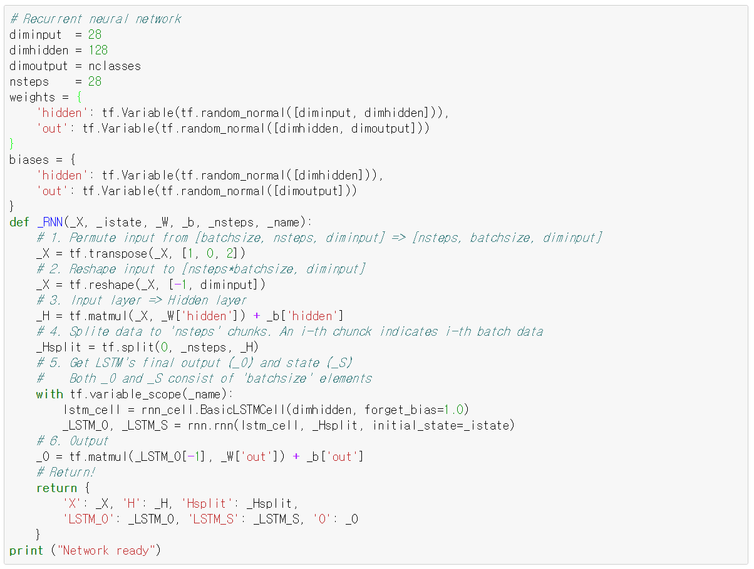
Construct Network
This part is similar to other networks.
Make a list for mini-batch learning.
LSTM, so simple!
Output layer

Slide 5
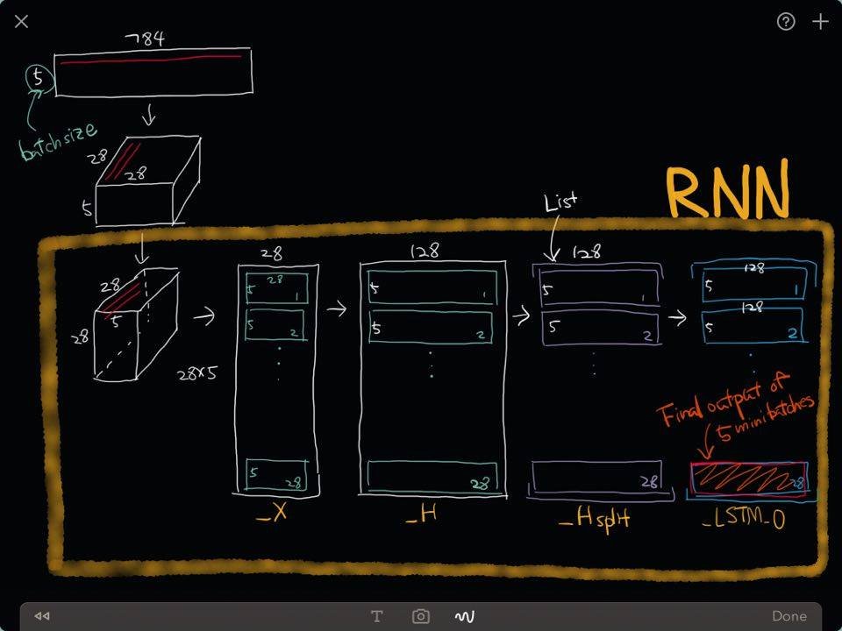
This is how we will optimize

Slide 6
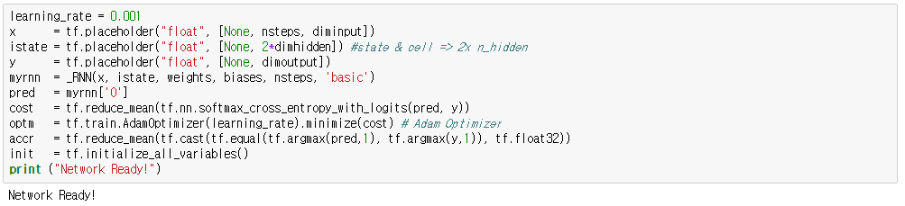
Define functions

Slide 7
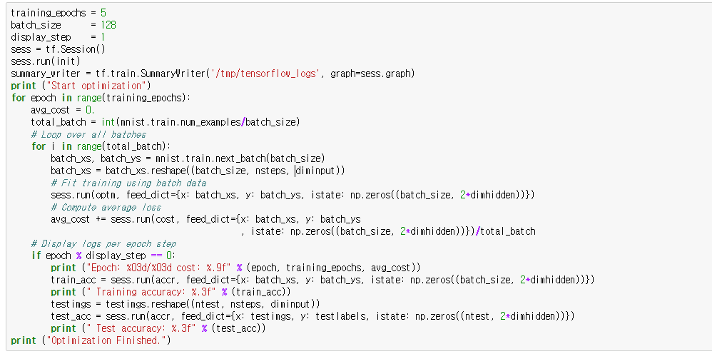
Optimize
This part is different
Initial state

Slide 8
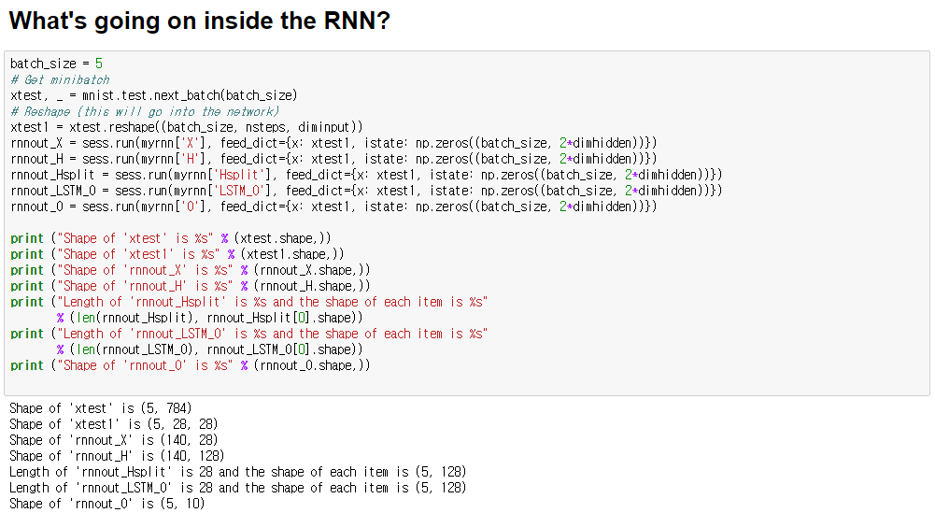
Look inside

Slide 9
Recall

